Slide 1
Hospital bed prediction
AKSHITA

Slide 2
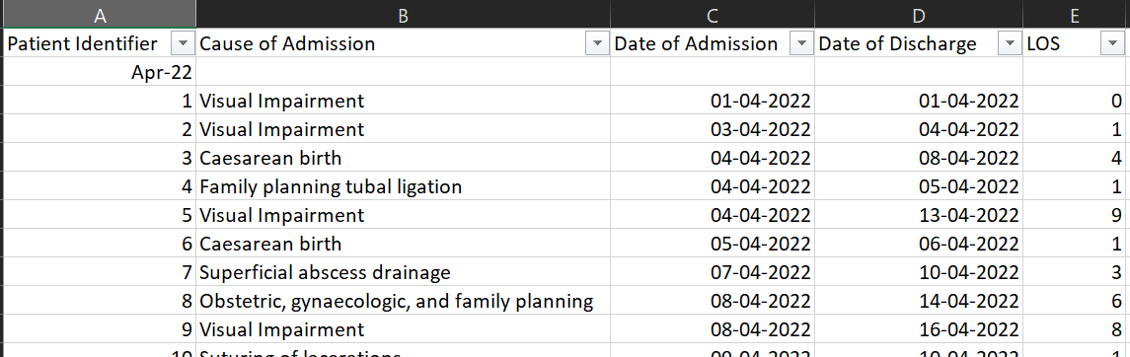
RECAP

Slide 3
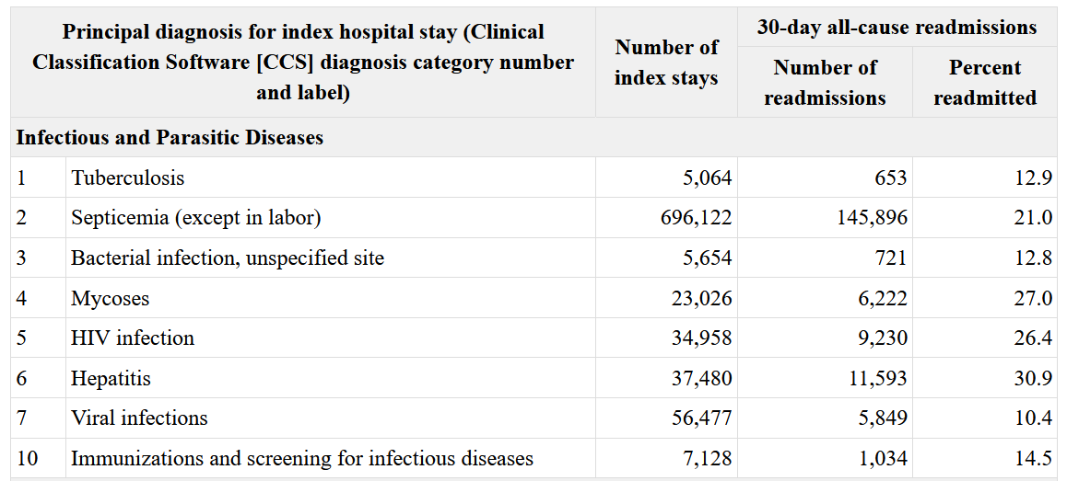
Readmission
According to the National Library of Medicine:

Slide 4
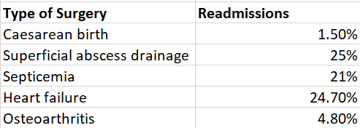
Readmission
Added this data to May’s admission

Slide 5
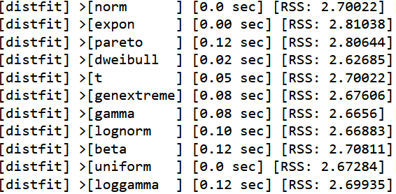
Determining the best probability distribution
Used a library called ditfist in Python to determine the best probability distribution

Slide 6
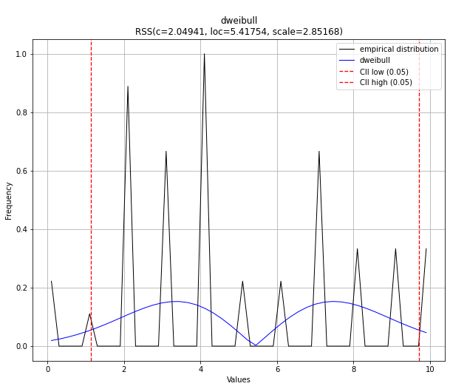
Heart failure

Slide 7
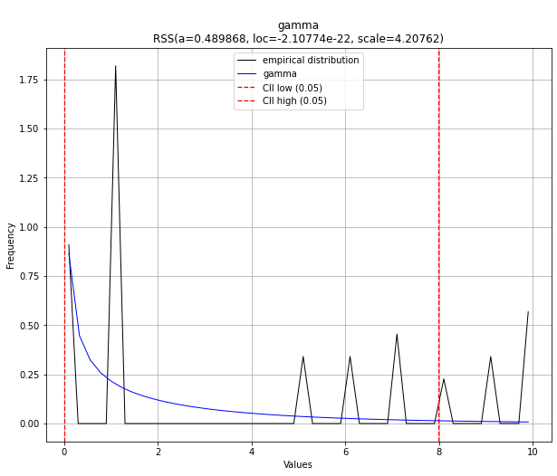
Visual impairment

Slide 8
Next steps
Modelling the data?
Stimulating data?

Slide 9
Thank you

